Slide 1
Data Capture & QA/QC
Kristin Vanderbilt, Ph.D.
Sevilleta LTER
New Mexico, USA

Slide 2
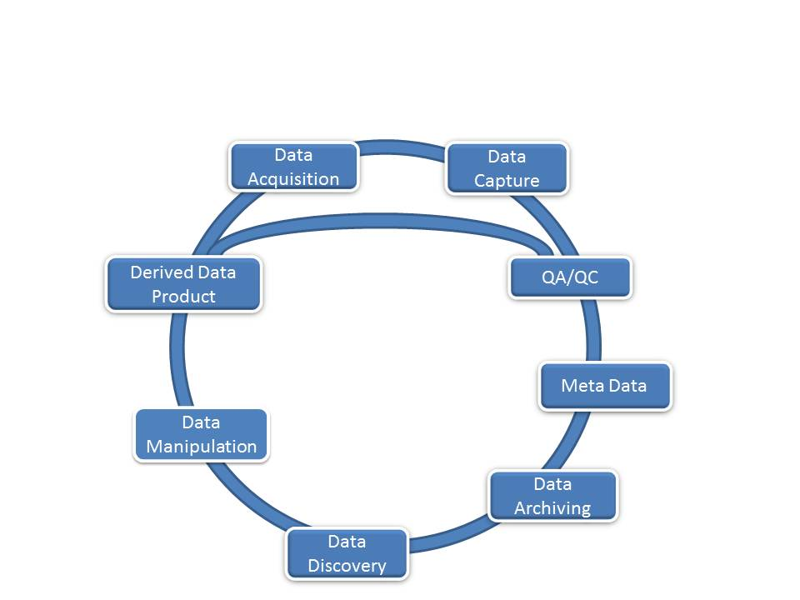
QA/QC
Mechanisms designed to prevent introduction of errors in to a dataset

Slide 3
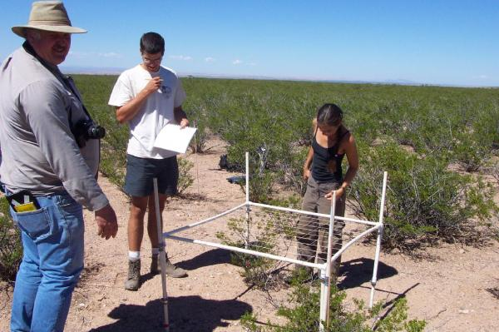
Loss of data quality can occur at many stages:
At the time of collection
Commission: Incorrect or inaccurate data are entered into a dataset
Misidentifying quad
Malfunctioning instrumentation
Sensor drift
Low batteries
Damage
Credit: http://sev.lternet.edu
Notes:
Loss of data quality can occur at many stages:
At the time of collection
During digitisation
During documentation
During storage and archiving
During analysis and manipulation
At time of presentation
And through the use to which they are put

Slide 4

Loss of data quality can occur at many stages:
During digitisation
Mistyping code
Transposing numbers
Notes:
Loss of data quality can occur at many stages:
At the time of collection
During digitisation
During documentation
During storage and archiving
During analysis and manipulation
At time of presentation
And through the use to which they are put

Slide 5
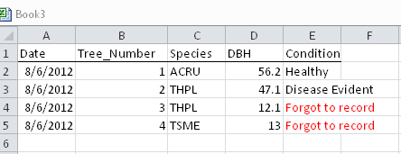
Loss of data quality can occur at many stages:
During documentation
Omission: Data or metadata are not recorded
Inadequate documentation of experimental design, sampling methods
Inadequate documentation of anomalies in the field
Forgetting to take measurement in the field
Notes:
Loss of data quality can occur at many stages:
At the time of collection
During digitisation
During documentation
During storage and archiving
During analysis and manipulation
At time of presentation
And through the use to which they are put

Slide 6
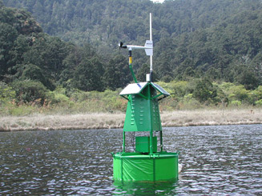
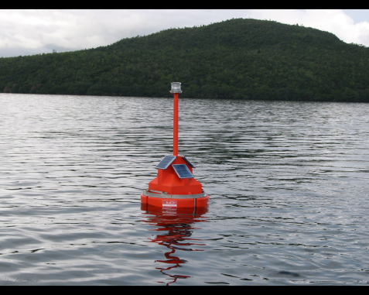
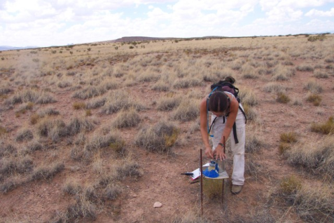

Scientist
Database
Graphics
Statistics
Datasheet Design
Training technicians
Documentation of procedures
Data Entry Constraints
Cost of error correction increases

Slide 7
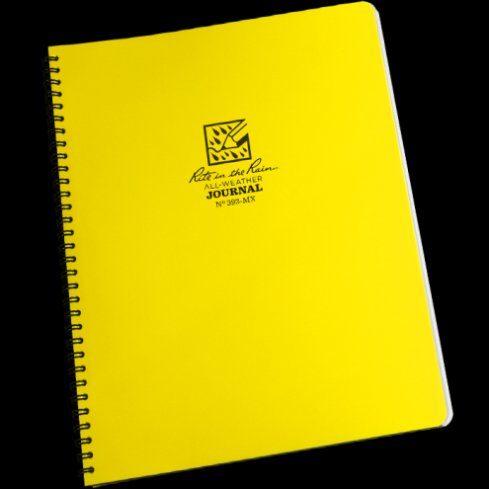
Datasheets facilitate data collection
Date
Time
Habitat Type
Macroplot #
Tree Species
DBH
Condition
Microplot #
Shrub Species
Shrub Cover%
Daubenmire Plot
Species
Cover %

Slide 8
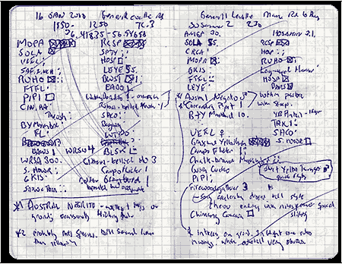
Hard to transcribe….

Slide 10
Flowering Plant Phenology – Data Collection Form Design
Three sites, each with 3 transects
On each transect, every species will have its phenological class recorded
Deep Well
Five Points
Goat Draw
1
2
3
1
2
3
1
2
3

Slide 11
Data Collection Form Development:
What’s wrong with this data sheet?
Plant Life Stage
_________________________________________
_________________________________________
_________________________________________
_________________________________________
_________________________________________

Slide 12
PHENOLOGY DATA SHEET
Collectors:_________________________________
Date:___________________ Time:_________
Location: deep well, five points, goat draw
Transect: 1 2 3
Notes: _________________________________________
Plant Life Stage
P/G V B FL FR M S D NP
P/G V B FL FR M S D NP
P/G V B FL FR M S D NP
P/G V B FL FR M S D NP
P/G V B FL FR M S D NP
P/G V B FL FR M S D NP
P/G V B FL FR M S D NP
P/G = perennating or germinating M = dispersing
V = vegetating S = senescing
B = budding D = dead
FL = flowering NP = not present
FR = fruiting

Slide 13
Sevilleta LTER NPP Study: At each location, record the percent cover and height of each plant species. Data are sampled on each quadrat.
N
N
1
2
1
2
Quadrats
3
4
3
4
Web 2
Web 1
E
W
E
W
1
2
3
4
Plot
Web 3
S
S
This study design is replicated at 3 sites: Deep Well, Five Points, and Goat Draw

Slide 14
Sevilleta LTER NPP Quadrat Cover Measurements
Date: ____________________
Data Collector: ____________________
Site: (circle one) Deep Well Goat Draw Five Points
Web: (circle one) 1 2 3
Plot: (circle one) N S E W
Quad | Species | Cover | Height

